Slide 1


Web Scraping and APIs for extracting data through the web

Slide 2
Outline
Quick Introduction: Web Scraping and APIs
Group Discussion. How do you plan to use Web Scraping/APIs in your research
Comparing Web Scraping vs APIs
Popular applications and packages for Web Scraping/APIs

Slide 3
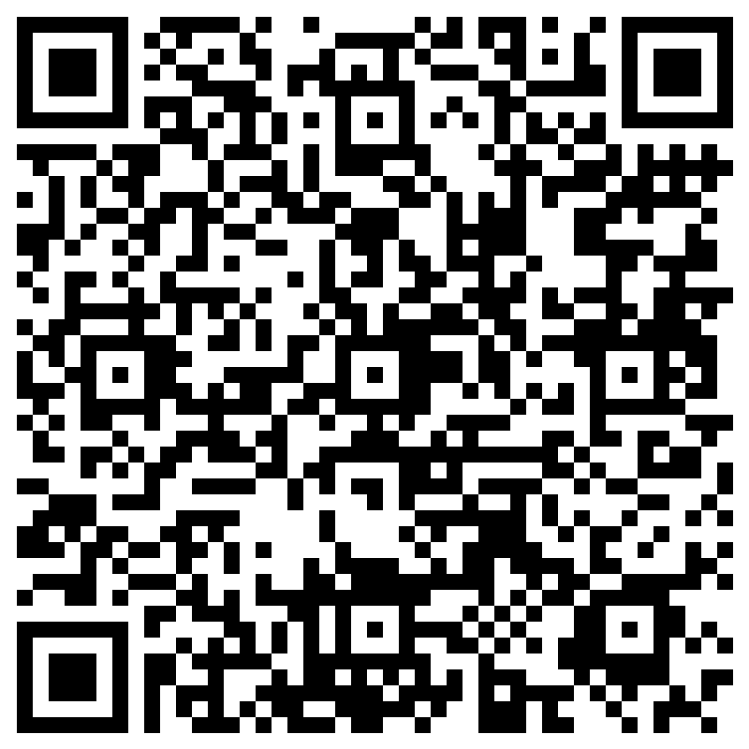
Attendance

Slide 4
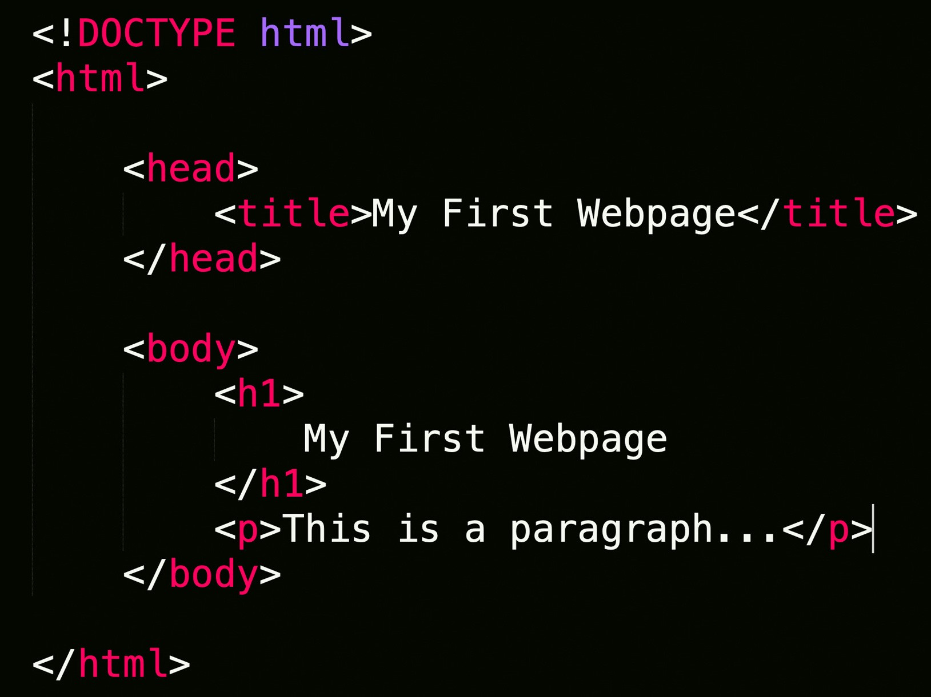
Web Scraping
Extraction of data from a website.
Loads HTML code from URL. User selects which content to keep.
Static and Dynamic content.

Slide 5
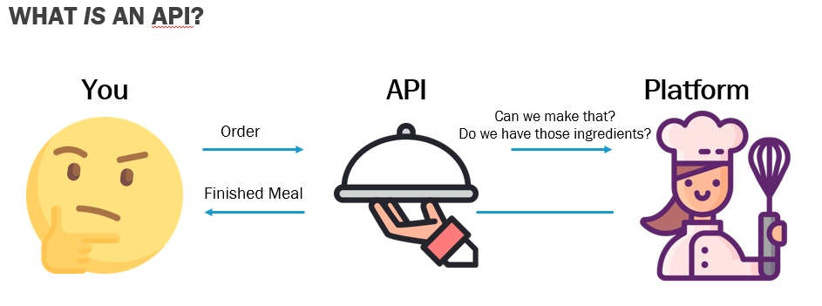
APIs
Allows communication and data exchange between 2 applications.
API Sample Data: https://jsonapi.org/examples/

Slide 6
What brought you here today? (Breakout rooms)
Who you are?
What you do(methods, research areas)?
What you hope to learn from today’s series?
How do you plan to use web scraping/APIs in your research?
Notes:
Who You Are
What You Do (methods, research areas)
What you hope to learn today/in this series?

Slide 7


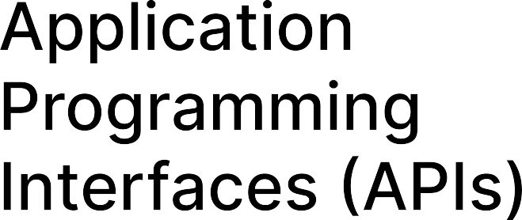
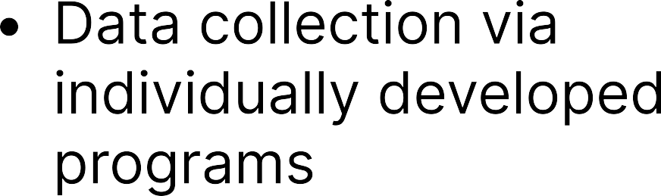






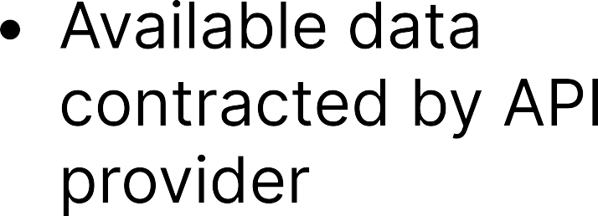
Web Scraping VS APIS

Slide 8
Applications of Web Scraping Techniques with Python

Slide 9













Slide 10
BeautifulSoup Example
Link Below to sample code
https://colab.research.google.com/drive/1FcY5EyDiBRowbykQUay-idMa1PUZx1SD?usp=sharing
Goal: Extract ‘Top items being scraped right now’ section. Pull item name, price, description, number of reviews.

Slide 11
Exercise
Link below to code. Fill in missing areas to complete scraping program
https://colab.research.google.com/drive/1egYeVhzxZJ_3AGEoK5bZIaxxLbpFBSLC?usp=sharing
Goal: Extract job title, job link, brief description provided.
Bonus: Place in Pandas dataframe and print
Website URL : https://realpython.github.io/fake-jobs/
Another practice website: https://realpython.github.io/fake-jobs/

Slide 12
Selenium Example
Link below to Sample Code
https://colab.research.google.com/drive/1FcY5EyDiBRowbykQUay-idMa1PUZx1SD?usp=sharing
Scraping principles for Selenium and BS4 are similar. Different Syntax
Goal: Traverse website link below. Extract price, title, description and reviews as before for all pages.
https://www.webscraper.io/test-sites/e-commerce/static/phones/touch

Slide 13
Selenium Exercise and Sample Code
Extract all titles, descriptions, price and reviews for all pages computers. Following URL
https://www.webscraper.io/test-sites/e-commerce/static/computers/laptops
Sample code:
https://colab.research.google.com/drive/1EyzRzzqg-CpUUfr85ATEEw6UiVE3bt_S?usp=sharing

Slide 14
Applications of API Techniques using Python

Slide 15
Reddit API
Requires keys to submit requests. Setup is quick, easy and free.
Sample code. Includes instructions for setup.
https://colab.research.google.com/drive/1XbHHRXuWzF_rMQ6dC-FAtob6Sfeh7q2u?usp=share_link
Goal: Search reddit by topic. Trending posts, recent posts, top posts. Extract data for title, author, post text, up votes, down votes, number of comments

Slide 16
Twitter API
Requires keys to submit requests. Setup is free, approval may take some time.
Sample code. Need bearer token to generate results.
https://drive.google.com/file/d/10X6mMmwZ9uw06zLFh__2fNCskDIS8lXj/view?usp=sharing
Goal: Search tweets by keywords, hashtags, tweets by specific users, tweets by location. Filter tweets by date.

Slide 17
Wikipedia API
Public and free to use at any time. No registration required.
Sample Code:
https://colab.research.google.com/drive/1Ab95XryOiL0dhwO4L1Axqcs8wBKlHTky?usp=share_link
Goal: search Wikipedia by search term. Extract article title, URL, content, links.

Slide 18
Thank you!
Contact us at CCSS-ResearchSupport@cornell.edu

